Slide 1
About Us
I'm a big believer in that if you focus on good skincare, you
really won't need a lot of make-up.

Slide 2

BioMiracle

Slide 3

Biomiracle Beauty Products
You're never too old to become younger.

Slide 4
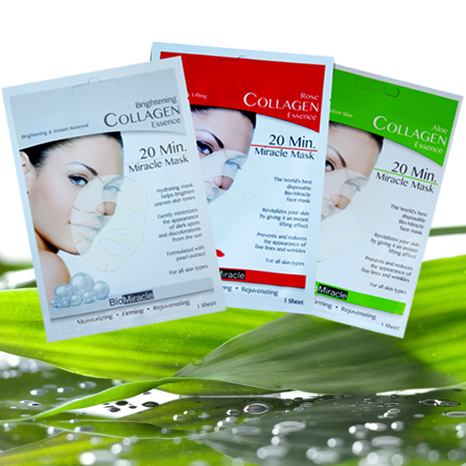
Biomiracle Beauty Products
You're never too old to become younger.

Slide 5
About Us
Biomiracle is a leading manufacturer of Health and Beauty.
Biomiracle has created a great range of products across
the beauty spectrum, At Biomiracle, we understand our skin and how essential its glow is to you. Biomiracle has available in market different type face mask and in different

Slide 6
Our Products
Brightening Collagen Mask
Anti-Ageing & Moisturizing Mask
Rose Collagen Mask
White Diamond And Black Pearl Hydro gel Mask
Spa Cucumber Papaya Mask- 5 pack
Charcoal Sculpting Mask
3 Step Detox 3 Pack Face Mask
Anti Wrinkle Miracle Eye Patches
BioMiracle Pure 24K Gold Hydrogel Eye Mask
BioMiracle Organic Aloe Mist Spray
BioMiracle Makeup Cleansing Towelettes
BioMiracle Aloe Vera Towelettes
LeBiome BioMiracle's Nature's Spa Cucumber Papaya Mask

Slide 7
Purchase On
Biomiracle products plays a major role and it is not only for the beauty purpose but it also works to keep us healthy. Our products will protect your skin from pimples, wrinkles, darkcircles and tightens your skin without any irritation.
Amazon:- https://amzn.to/2AMyVK0
Flipkart:- https://bit.ly/2OzXBO3
purplle:- https://bit.ly/2DbW0XT
website:https://www.biomiracle.in

Slide 8
Thank you
BIOMIRACLE INDIA

